Slide 1
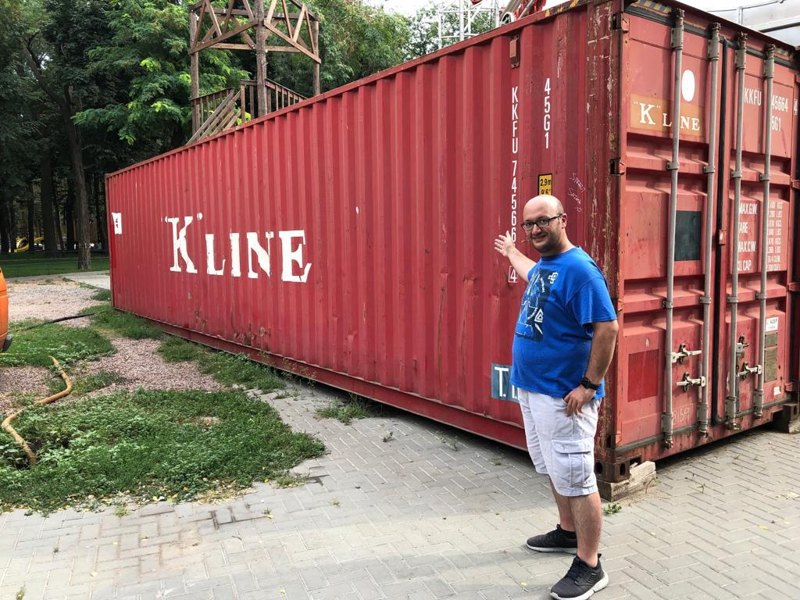
DOCKER 101
Serdar mumcu (ICTERRA)
Serdar.mumcu@ICTERRA.com

Slide 2
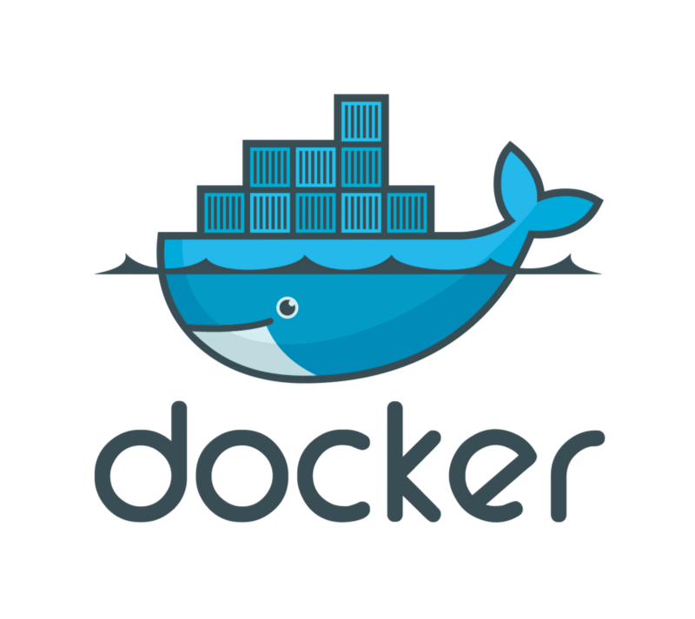
Outlıne
What is Container?
What is Docker?
Docker Benefits
Docker Terminology
Docker Installation
Docker CLI Usage
Docker Persistence
Docker Networking

Slide 3
outlıne
Custom Docker Images
Docker-Compose
Elasticsearch, Redis Cluster
Node.js
Docker Machine
Docker Swarm
Deployment to Digital Ocean
Deployment to AWS

Slide 4
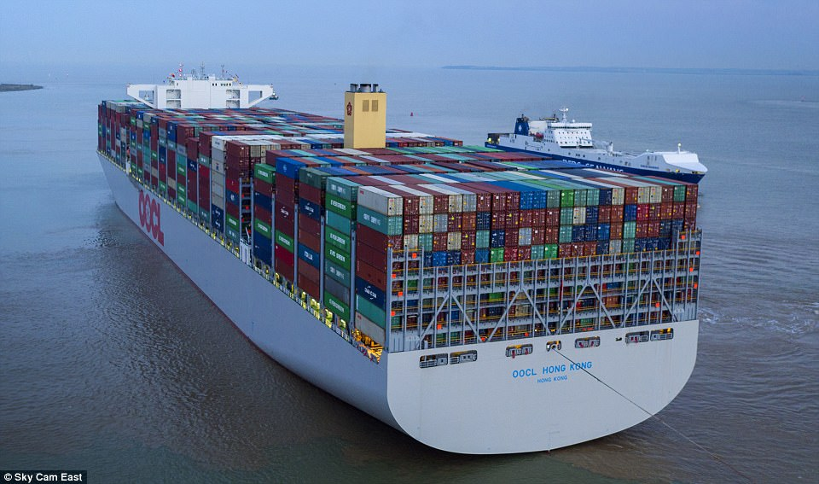
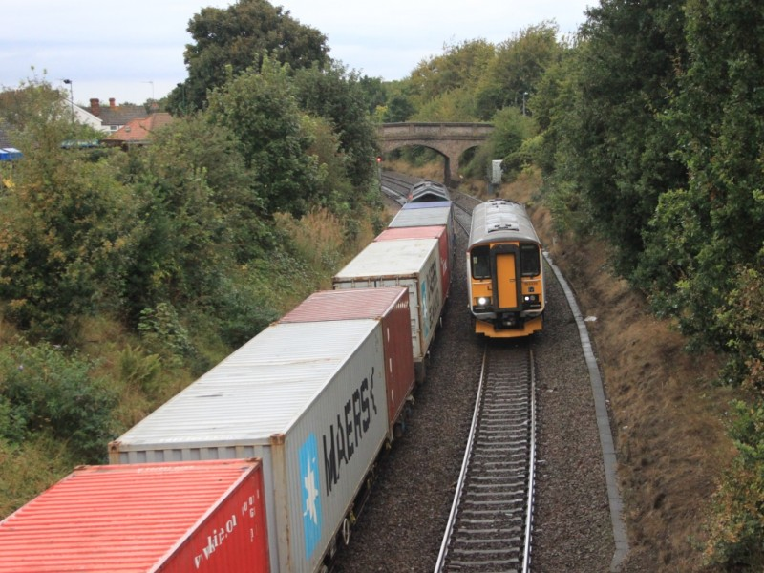
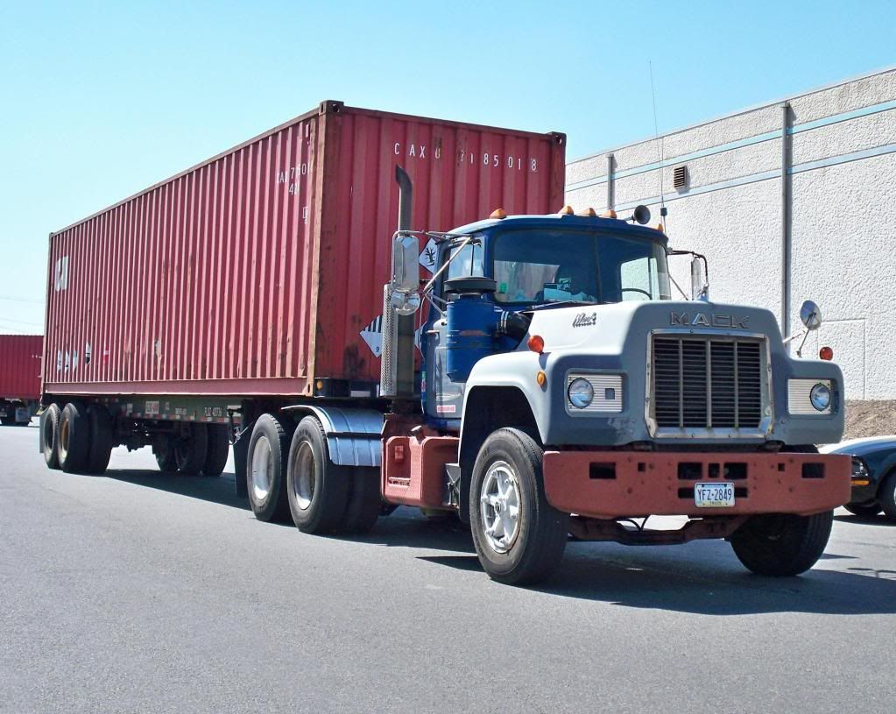
what ıs Container?

Slide 5
what ıs docker?
Solomon Hykes
Since 2013
Docker Inc.
Written in Go
Moves very fast
Lightweight

Slide 6
DOCKER BENEFITS
Immutable Infrastructure
Portability
Easy Developer Onboarding
Learning new technologies
Dev-Prod Parity
Infrastructure Utilization
Fast and Easy Deployments
Microservices Support
Support for Cont. Int/Del.

Slide 7
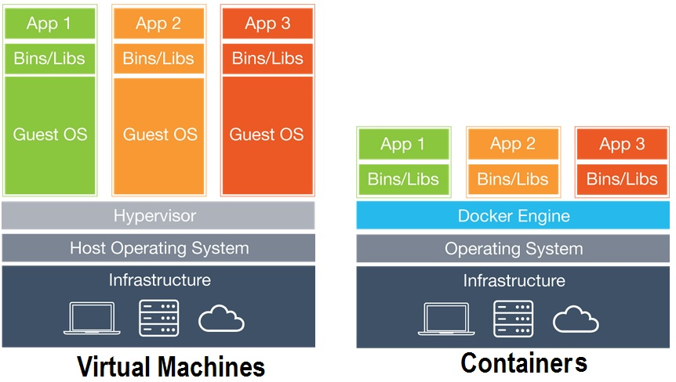
Vm vs. contaıners

Slide 8
DOCKER TERMINOLOGY
Docker Image
Docker Container
Docker Volume
Docker Registry
Docker CLI
Docker Daemon (Engine)

Slide 9
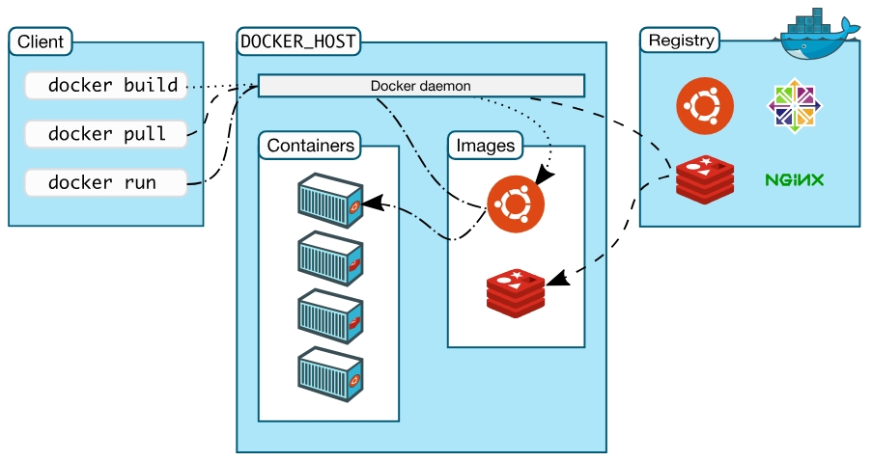
Docker archıtecture

Slide 10
Docker ınstallatıon
https://get.docker.com/
Docker Hub
Mac , Windows, Centos, Debian, Fedora, Ubuntu, Raspberry Pi
Direct: Linux, W. Server 2016 / Indirect: Windows 10 Pro/Ent (Hyper-V), Mac (HyperKit)
Windows 7/8/8.1, Older versions of Mac or Window 10 Home (Docker Toolbox)
IaaS (AWS, Azure)
Visual Studio Code (Recommended)
https://labs.play-with-docker.com/

Slide 11
Docker CLI
docker version / docker info
docker / docker --help
docker container run --rm
docker image ls
docker volume ls
docker ps

Slide 12
Docker CLI
docker container run -p 8080:80 nginx:v1.14
--name
--detach
https://hub.docker.com/explore/
docker stop
docker start
docker logs

Slide 13
Docker CLI
docker container just a process in the host OS
docker run --name mongo –d mongo
docker top mongo
ps aux
docker run -it --rm --privileged --pid=host docker4w/nsenter-dockerd

Slide 14
Docker CLI (Assıgnment)
https://docs.docker.com/
--help
nginx (80:80), postgresql (5432:5432), httpd (8080:80)
use –d and –name
use -e or --env to pass POSTGRES_PASSWORD=my-secret-pw

Slide 15
Docker CLI
docker container top
docker container inspect
docker container stats
docker inspect proxy –format ‘{{ .NetworkSettings.IPAddress }}’
docker run --rm tutum/curl curl <ip-address>
docker stop $(docker ps -aq)

Slide 16
Docker CLI
Getting a shell inside containers (no ssh needed)
docker container run –it
docker container exec –it
docker container run –it –name proxy –p 8080:80 nginx bash
When you exit, container will stop since we changed the default command
docker container start -ai ubuntu
docker container run -it alpine sh

Slide 17
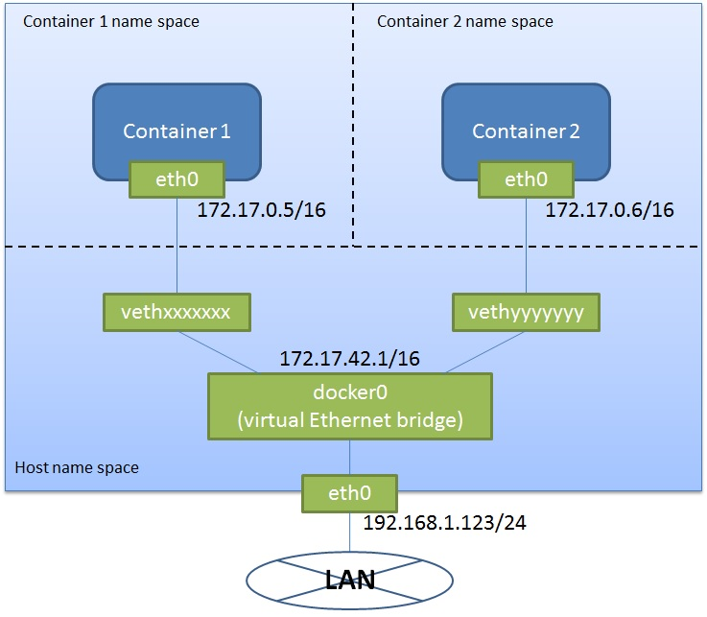
Docker NETWORKING

Slide 18
Docker NETWORKING
docker container run –p
docker container port <container>
docker network ls
Bridge, Host, None
docker network inspect bridge
docker network create mynetwork (--driver)

Slide 19
Docker NETWORKING
docker container run -d --name proxy –network mynetwork nginx
docker network inspect mynetwork
docker network connect
docker network disconnect
DNS (we cannot rely on the IP Addresses)
docker container run –d --name newproxy --network mynetwork nginx
docker container exec -it newproxy ping proxy
--link (for default bridge network) - in docker-compose it is easier

Slide 20
Docker NETWORKING
docker network create testnetwork
docker container run –d --net testnetwork --net-alias mysearch elasticsearch:2
docker container run –d --net testnetwork --net-alias mysearch elasticsearch:2
docker container run --rm --net testnetwork alpine nslookup mysearch
docker container run --rm --net testnetwork centos centos curl –s mysearch:9200

Slide 21
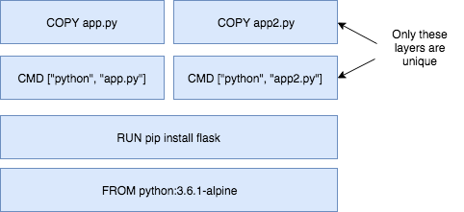
DOCKERFILE: CREATING CUSTOM DOCKER IMAGES
Image: App binaries and dependencies (No kernel, no kernel modules)
Image layers
docker history nginx:latest

Slide 22
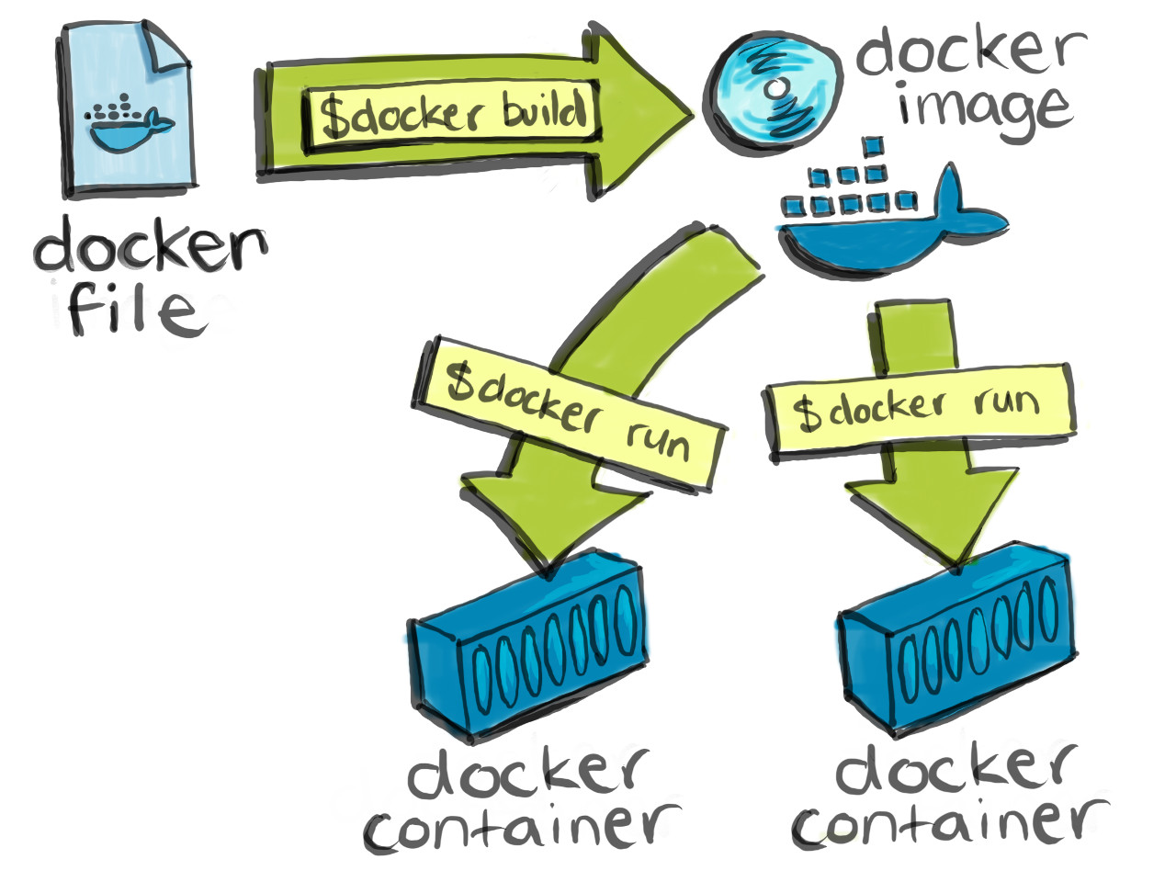
DOCKERFILE: CREATING CUSTOM DOCKER IMAGES
Dockerfile
FROM
ENV
RUN
COPY
EXPOSE
CMD

Slide 23
DOCKERFILE: CREATING CUSTOM DOCKER IMAGES
docker image build –t customnginx .

Slide 24
DOCKERFILE: CREATING CUSTOM DOCKER IMAGES
dockerize a node.js application

Slide 25
Docker PERSISTENCE
Data Volumes
https://github.com/docker-library/postgres/blob/master/10/Dockerfile
docker volume ls / rm / prune / inspect /create
docker image inspect postgres
docker container inspect postgres
docker volume inspect <volume-id>

Slide 26
Docker PERSISTENCE
docker container run -d --name db -e POSTGRES_PASSWORD=mysecretpw -v postgres-db:/var/lib/postgresql/data postgres
you may delete the container and mount the same volume again to another container
docker volume create --help

Slide 27
Docker PERSISTENCE
Bind Mounts
... run -v /Users/user1/stuff:/path/container (mac/linux)
... run -v //c/Users/user1/stuff:/path/container (windows)
docker run -d --name proxy1 -v C:\Users\Serdar\Desktop\dockerEgitim\bindmount:/usr/share/nginx/html -p 8080:80 nginx

Slide 28
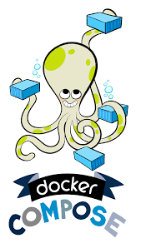
DOCKER COMPOSE
docker-compose.yml
docker-compose CLI

Slide 29


DOCKER COMPOSE
Creating elasticsearch and redis clusters locally with docker compose

Slide 30

DOCKER MaCHİNE
Using dockercloud and dockerhub for continuous integration

Slide 31

DOCKER SWARM MODE
Using dockercloud and dockerhub for continuous integration

Slide 32


DOCKER DEPLOYMENT
Digital Ocean Deployment
AWS

Slide 33
The end
Any questıons or comments?

